Slide 1
Key Performance Indicators

Slide 2
Overview of Invest NI KPI Outputs

Slide 3
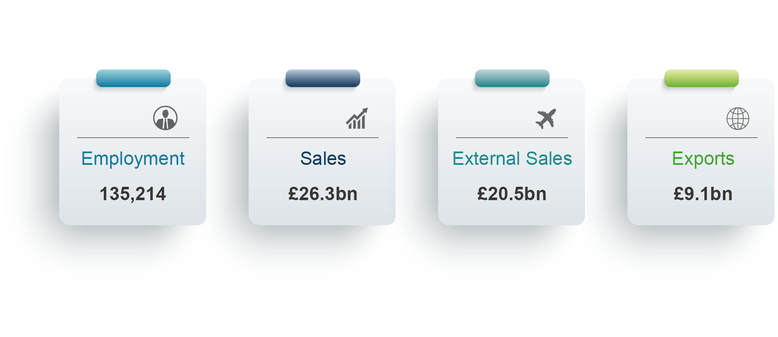
Headline Statistics
2022

Slide 4
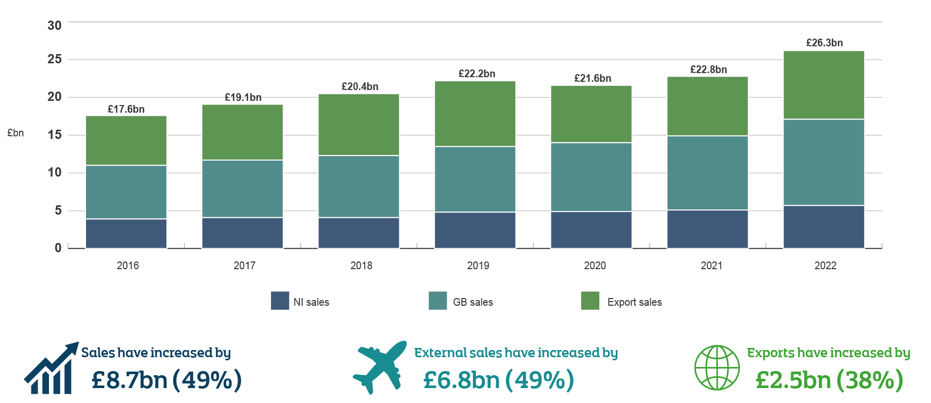
All Portfolio Sales Trends
2016 to 2022

Slide 5
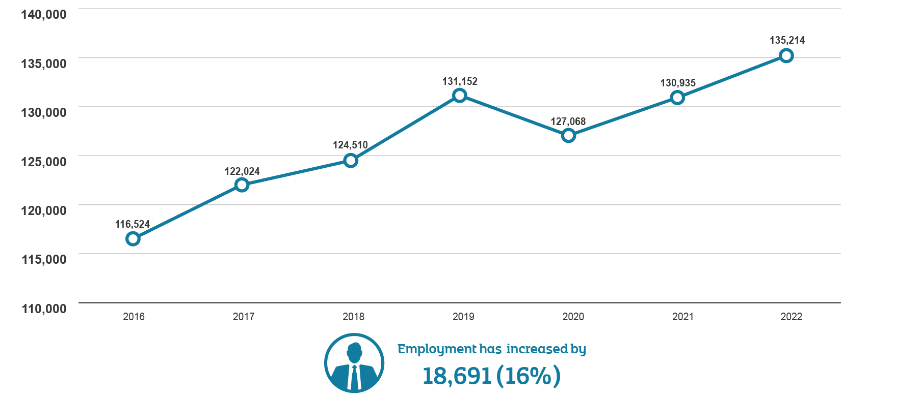
All Portfolio Employment Trends
2016 to 2022

Slide 6
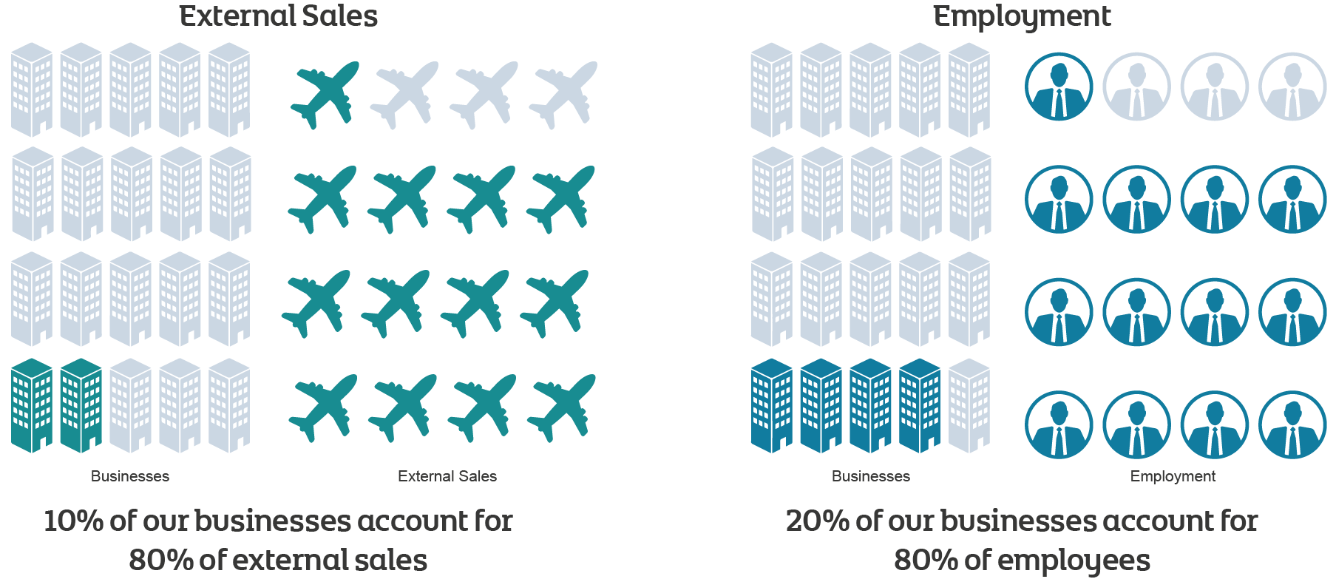
Impact of Key Customers
2022

Slide 7
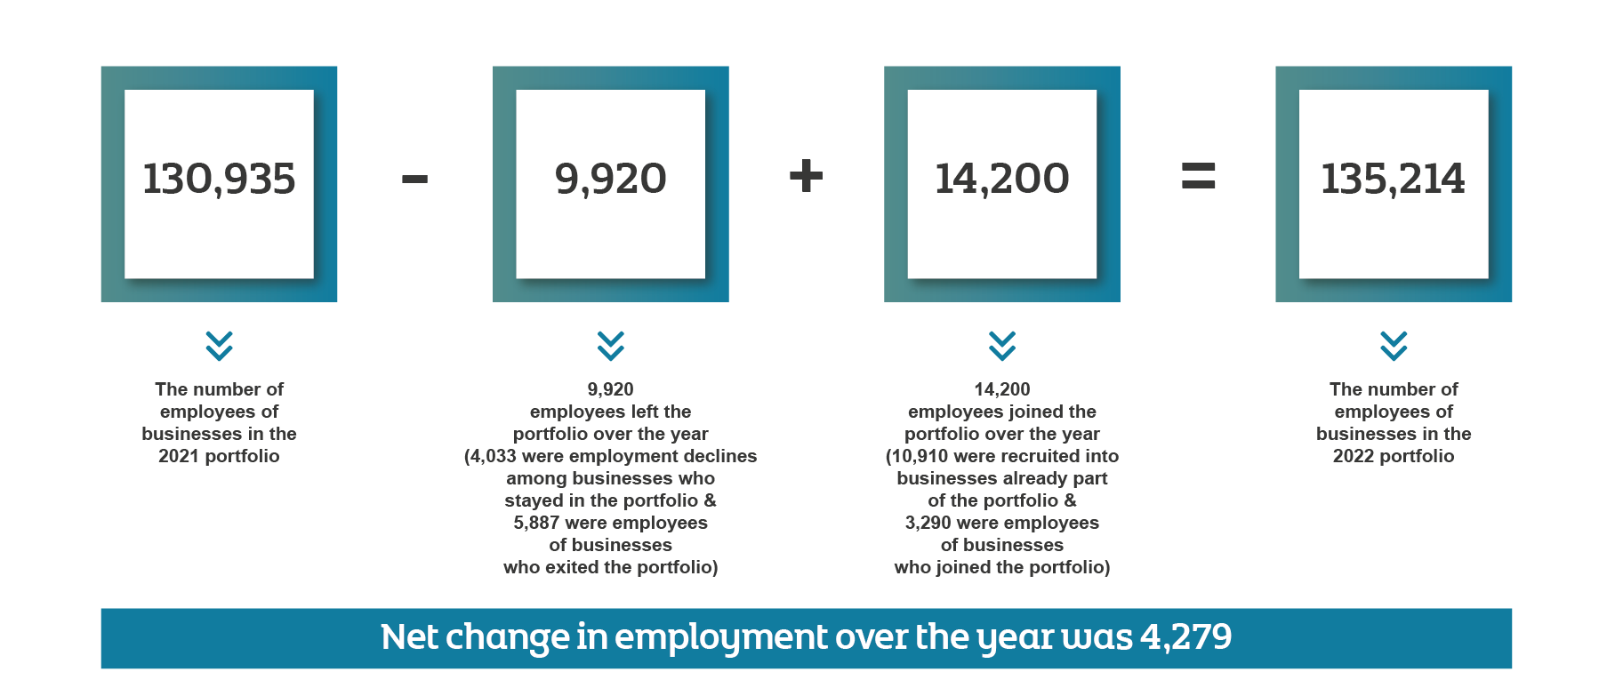
Employment Change in the Portfolio
2021 to 2022

Slide 8
KPIs by Industry

Slide 9
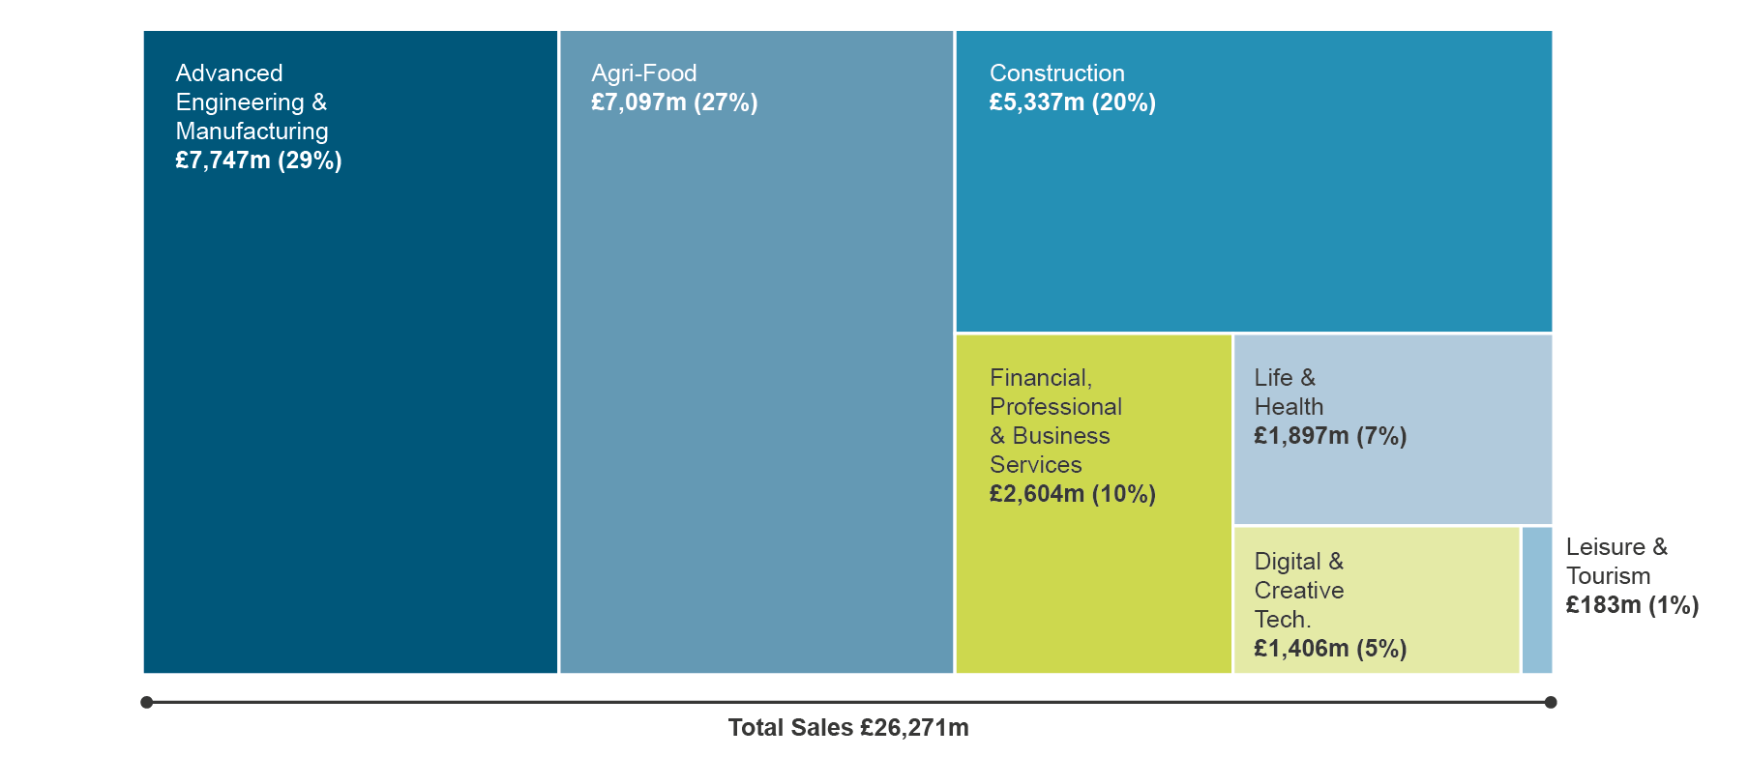
KPI Sales by Sector
2022

Slide 10
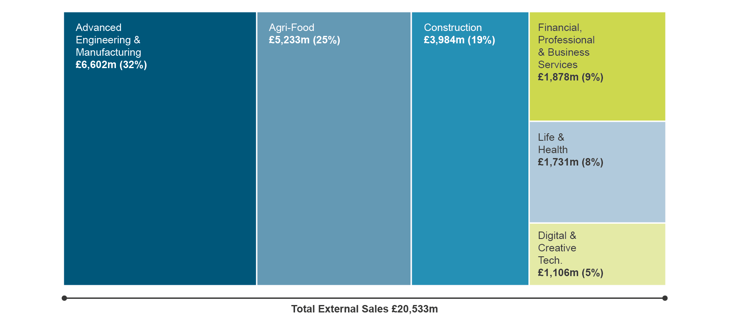
KPI External Sales by Sector
2022

Slide 11
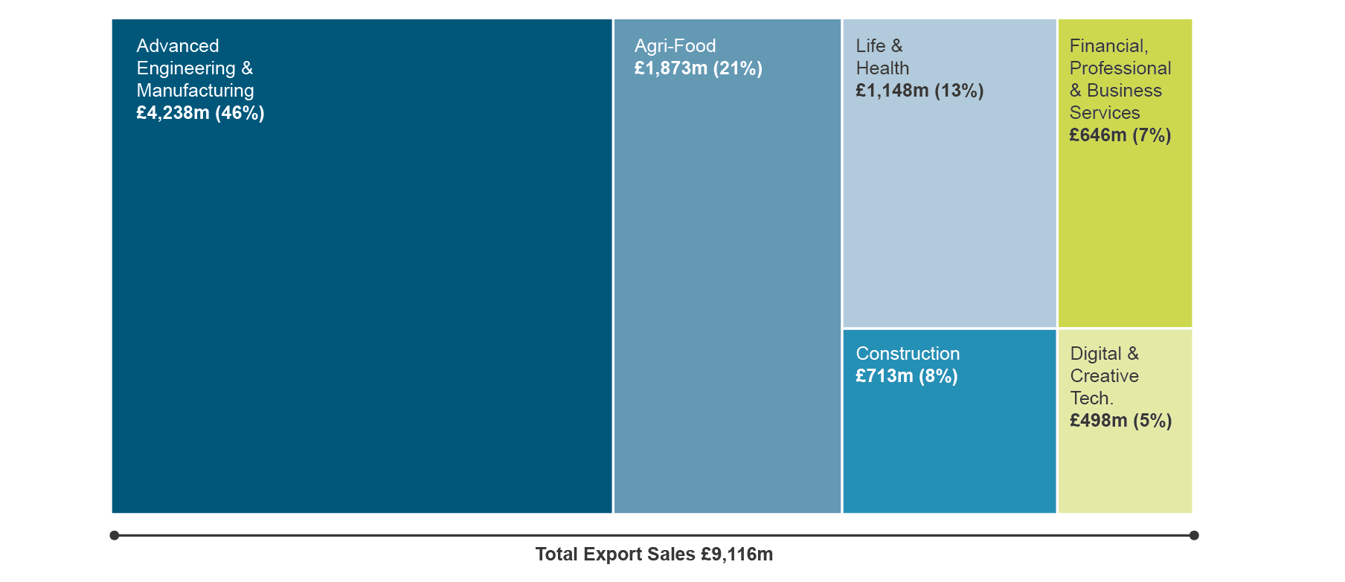
KPI Exports by Sector
2022

Slide 12
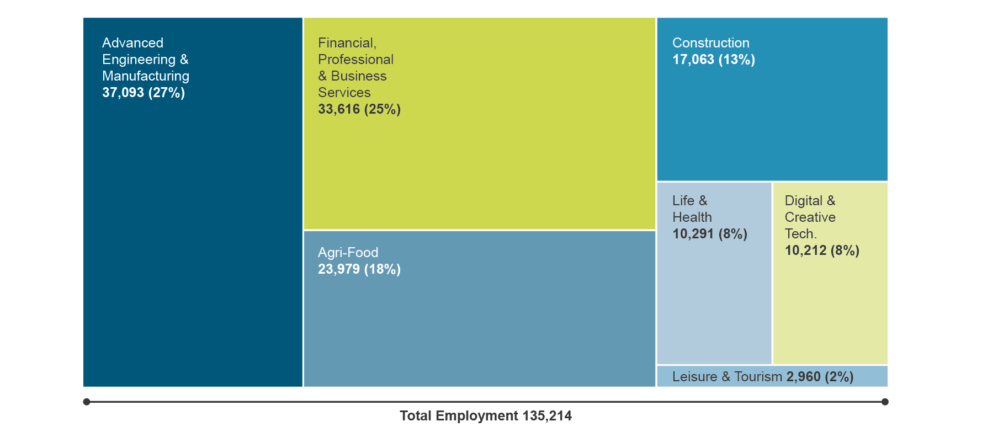
KPI Employment by Sector
2022

Slide 13
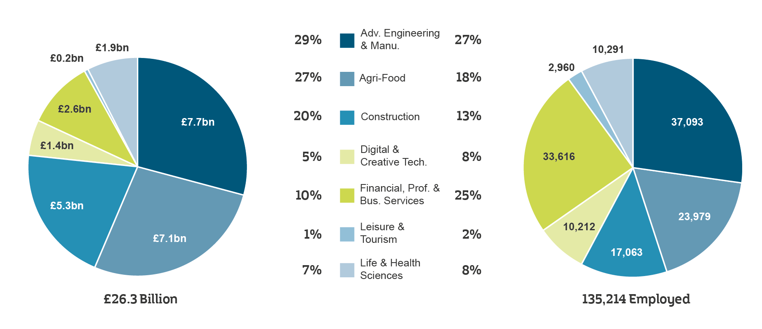
KPI Sales and Employment by Sector
2022

Slide 14
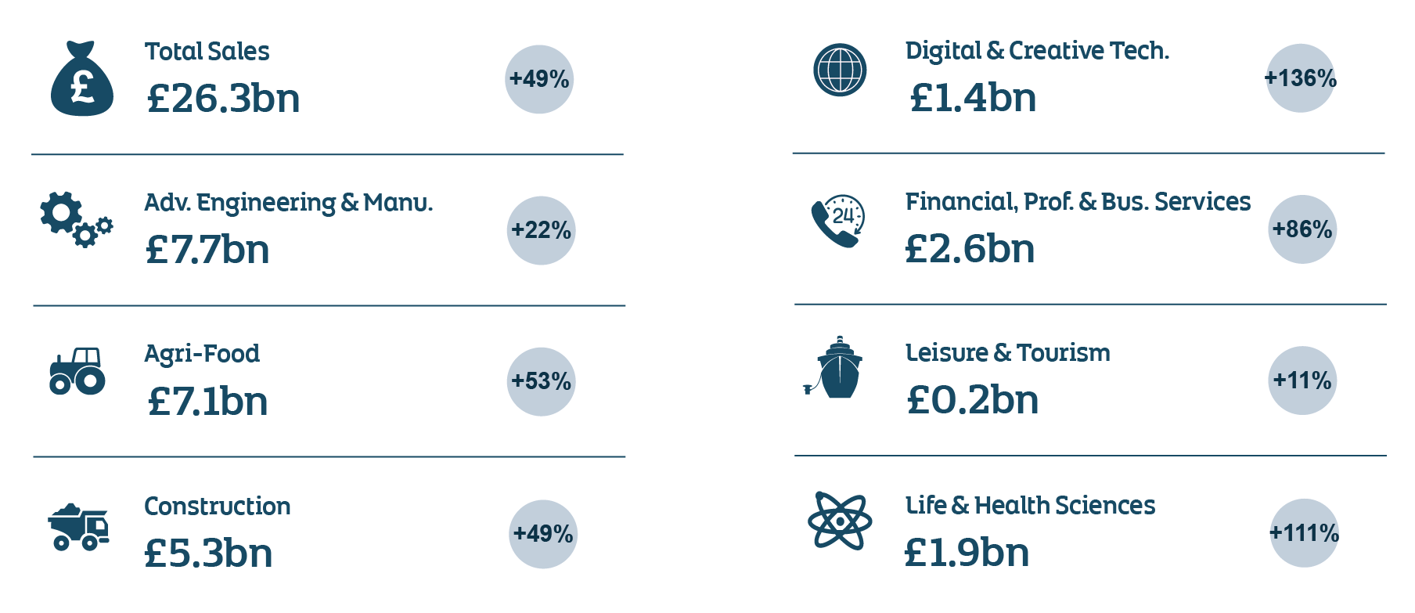
KPI Sector Performance and Growth Trends
2016 to 2022

Slide 15
KPIs by Market Destination

Slide 16
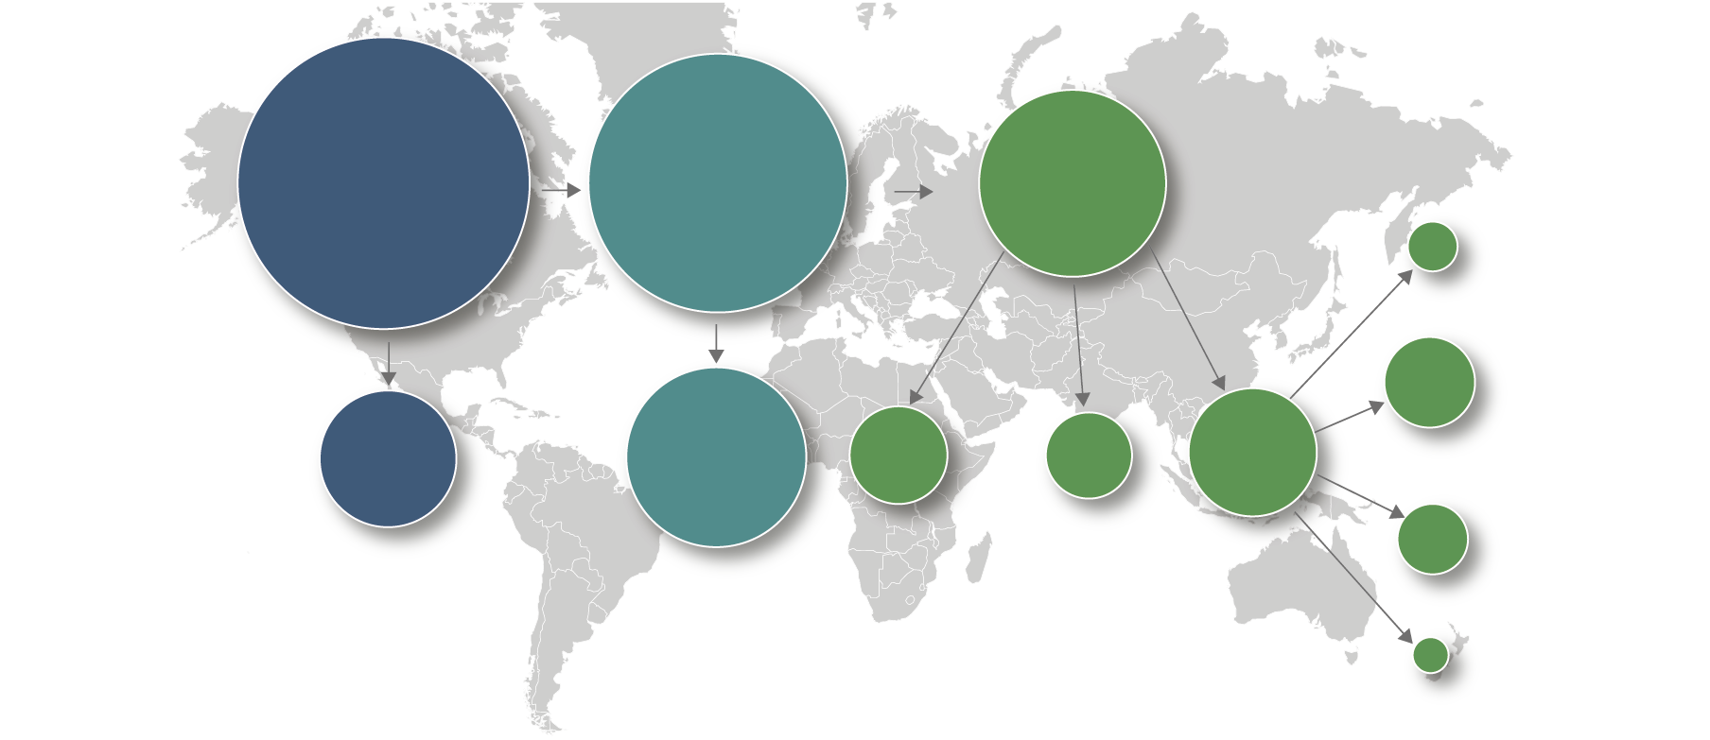
KPI Sales Performance
2022
100% Total Sales
External Sales
£20.5bn
Exports
£9.1bn
Sales
£26.3bn
Growth £2.8bn
Rate +16%
Growth £1.3bn
Rate +16%
Growth £3.5bn
Rate +15%
IMEA
£0.4bn
Growth +£0.02bn
Rate +4%
Americas
£2.4bn
Growth +£0.3bn
Rate +16%
NI
£5.7bn
GB
£11.4bn
RoI
£2.7bn
RoEU
£2.1bn
RoW
£4.1bn
APAC
£1.1bn
Growth +£0.1bn
Rate +15%
10%
Total
Sales
8%
Total
Sales
16%
Total
Sales
22% Total Sales
43% Total Sales
Russia &
Non-EU
£0.2bn
Growth +£0.02bn
Rate +11%
Growth +£0.7bn
Rate +13%
Growth +£1.6bn
Rate +16%
Growth
+£0.4bn
Rate +16%
Growth
+£0.3bn
Rate +16%
Growth
+£0.5bn
Rate +14%

Slide 17
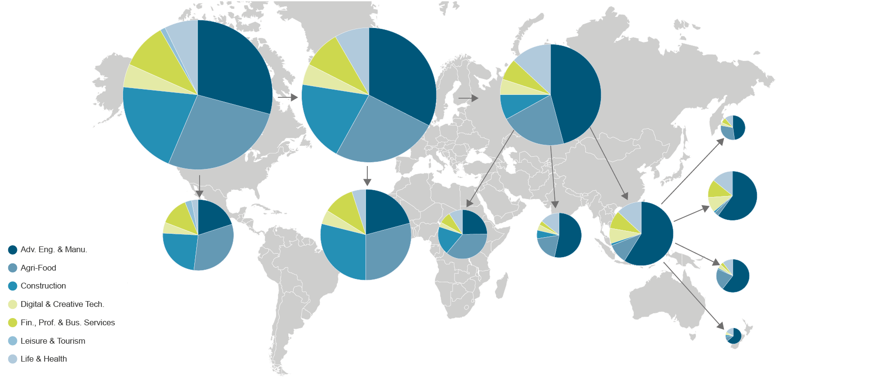
KPI Sales Performance
2022
100% Total Sales
External Sales
£20.5bn
Exports
£9.1bn
Sales
£26.3bn
Growth £2.8bn
Rate +16%
Growth £1.3bn
Rate +16%
Growth £3.5bn
Rate +15%
IMEA
£0.4bn
Growth +£0.02bn
Rate +4%
Americas
£2.4bn
Growth +£0.3bn
Rate +16%
NI
£5.7bn
GB
£11.4bn
RoI
£2.7bn
RoEU
£2.1bn
RoW
£4.1bn
APAC
£1.1bn
Growth +£0.1bn
Rate +15%
10%
Total
Sales
8%
Total
Sales
16%
Total
Sales
22% Total Sales
43% Total Sales
Russia &
Non-EU
£0.2bn
Growth +£0.02bn
Rate +11%
Growth +£0.7bn
Rate +13%
Growth +£1.6bn
Rate +16%
Growth
+£0.4bn
Rate +16%
Growth
+£0.3bn
Rate +16%
Growth
+£0.5bn
Rate +14%

Slide 18
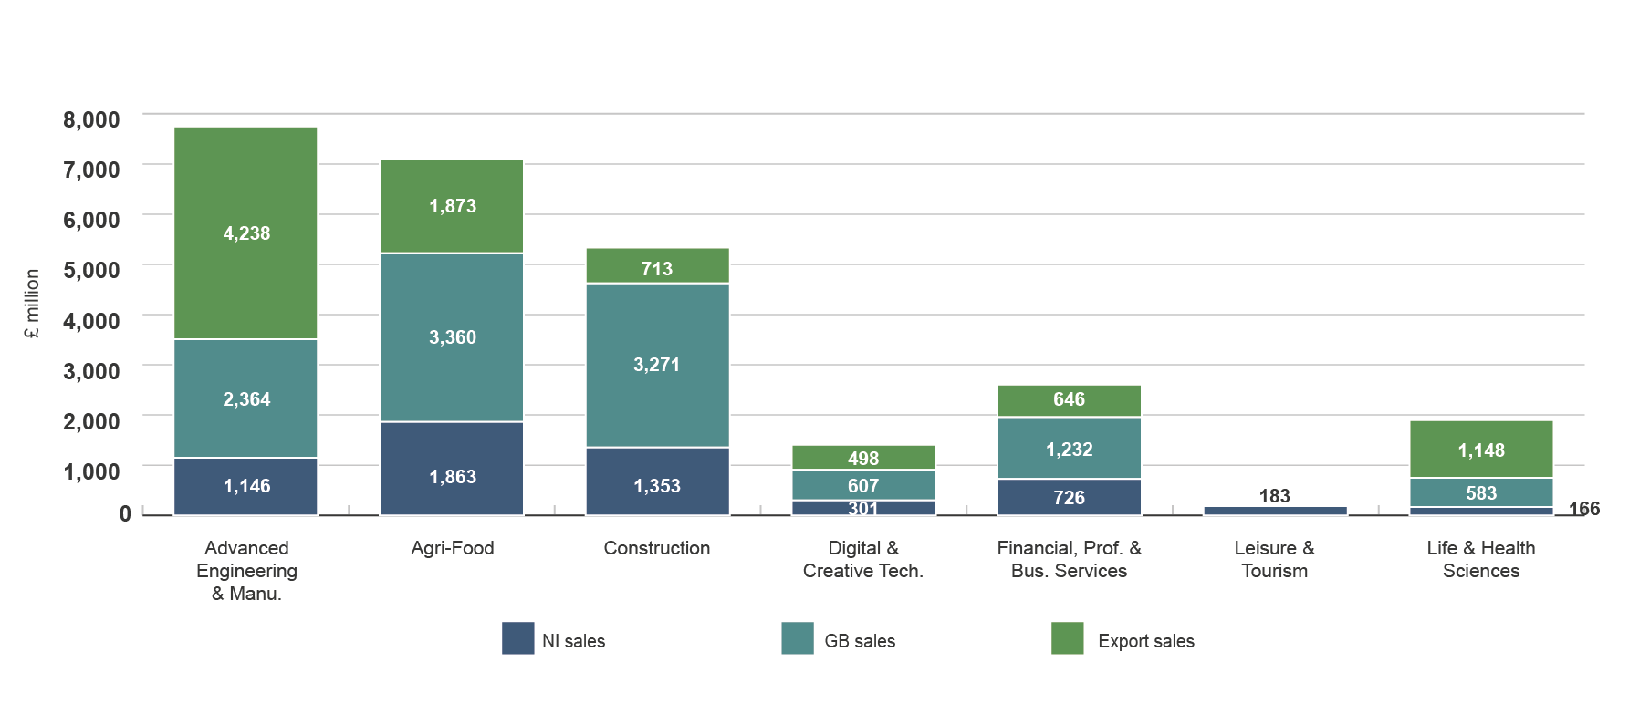
KPI Sales Performance by Sector
2022

Slide 19
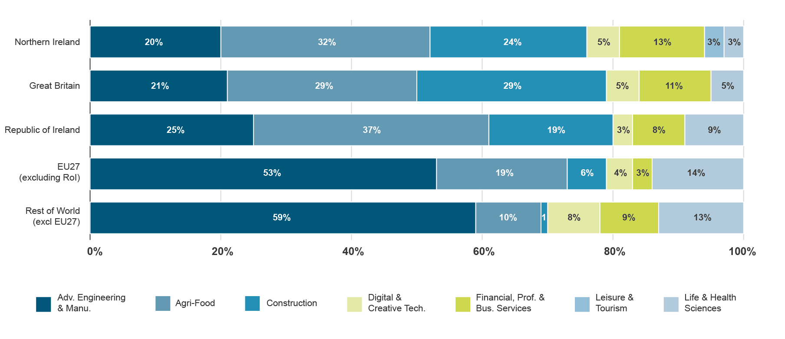
KPI Sector Contribution by Broad Destination of Sales
2022

Slide 20
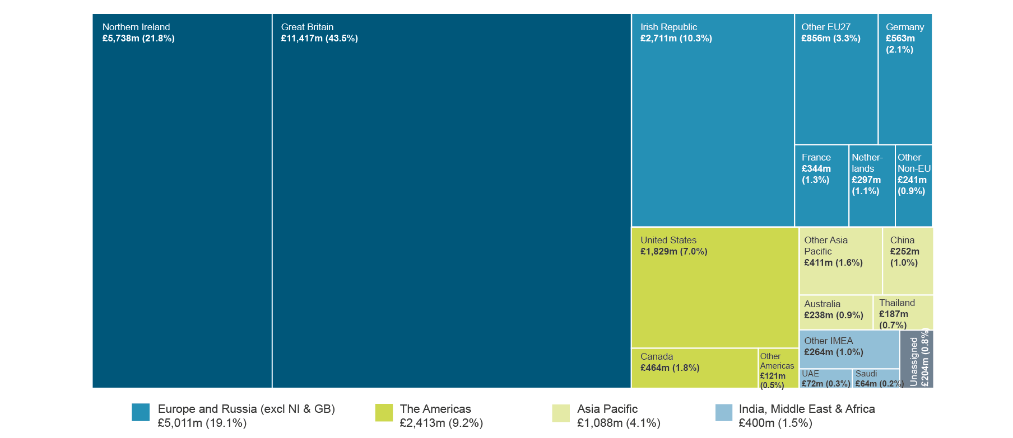
KPI Destination of Sales
2022

Slide 21
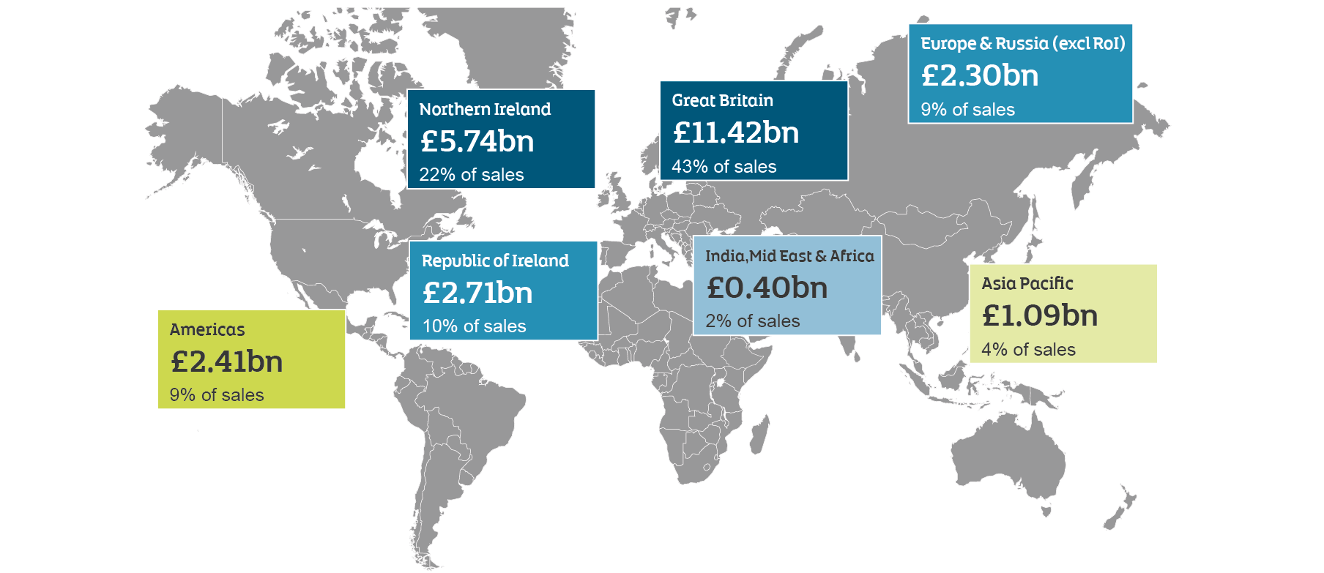
KPI Destination of Sales by Trade Territory
2022

Slide 22
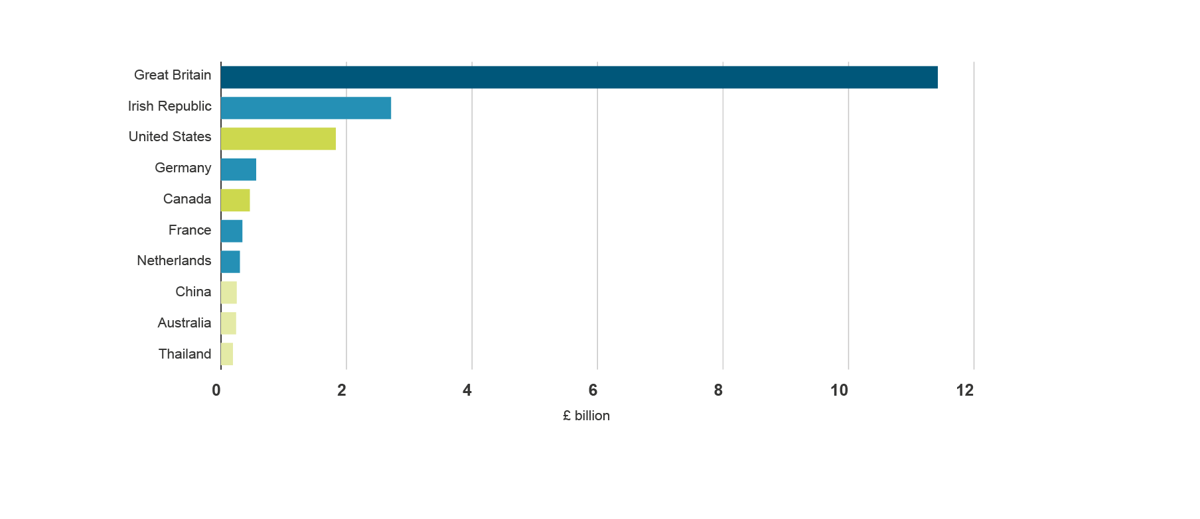
KPI Top External Sales Destinations
2022
56%
of sales outside NI
are to Great Britain
Total external sales = £20.5bn

Slide 23
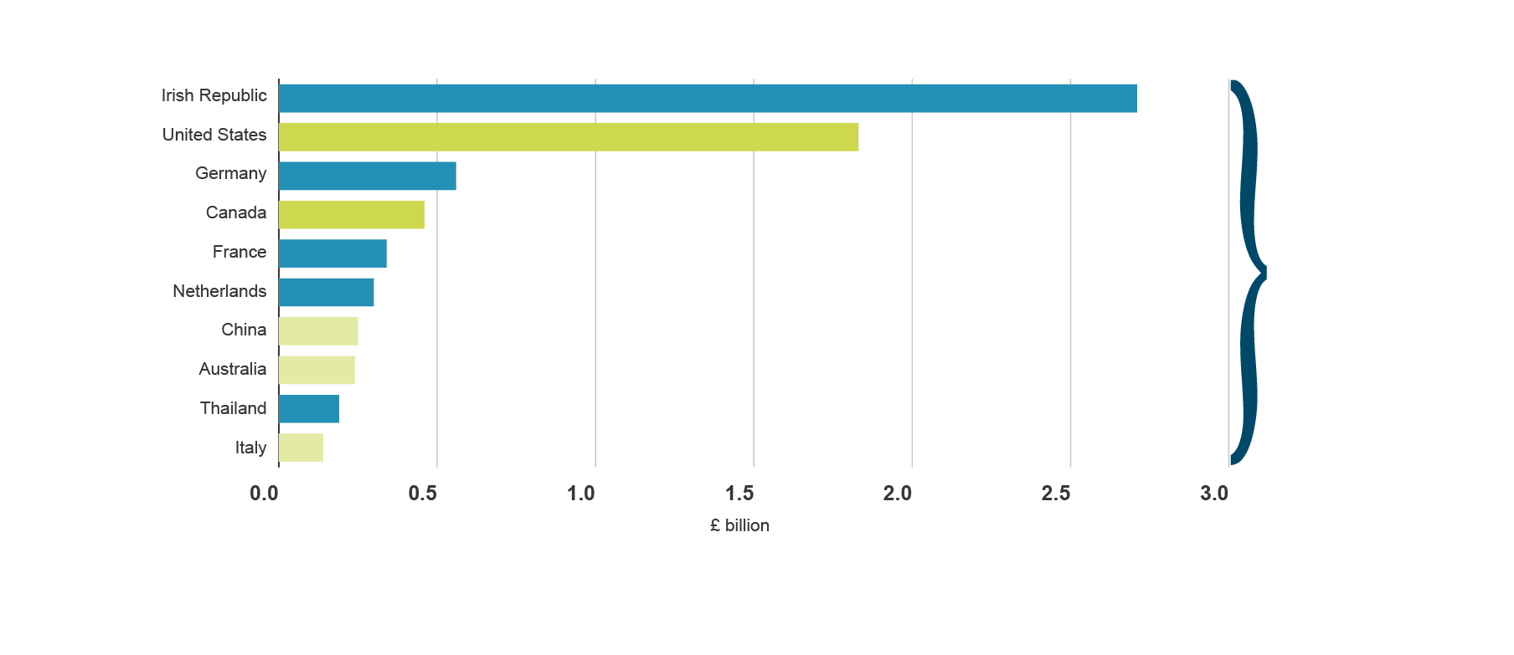
KPI Top Exports Destinations
2022
77%
Total exports = £9.1bn

Slide 24
Cohort Change
2021 to 2022*
*Change is based on those businesses for which we have data for both years of analysis

Slide 25
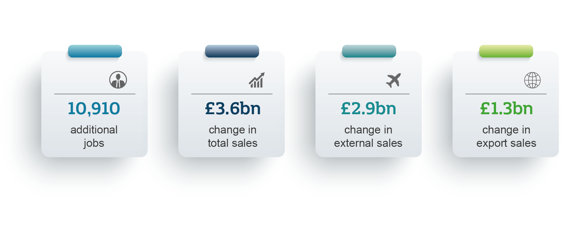
Cohort Growth
2021 to 2022

Slide 26
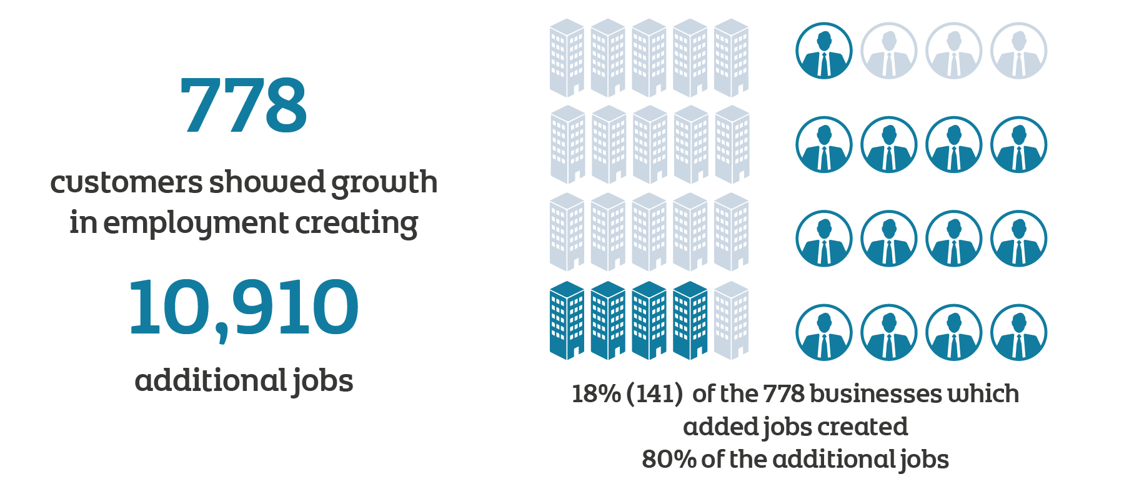
Cohort Contribution – Employment
2021 to 2022

Slide 27
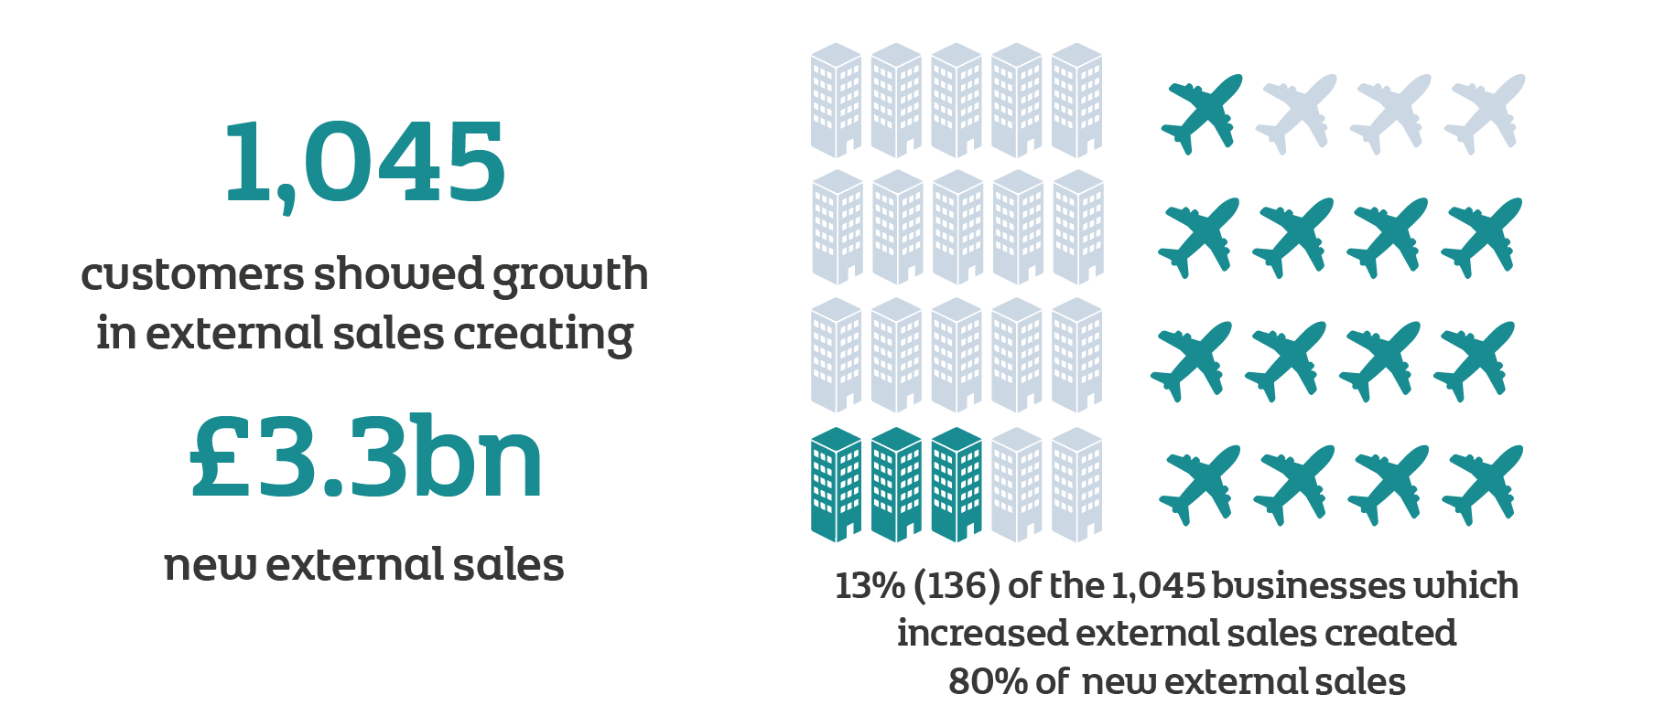
Cohort Contribution – External Sales
2021 to 2022

Slide 28
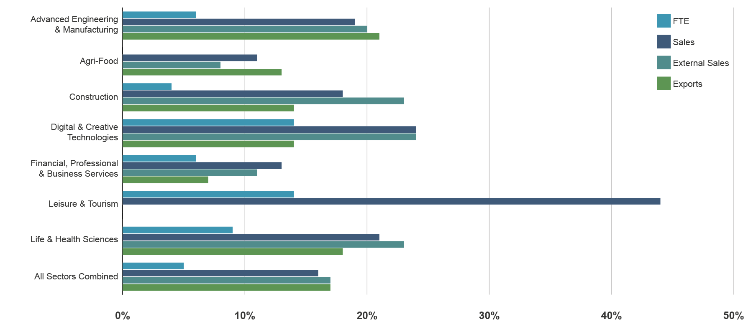
Cohort Growth Rates by Sector
2021 to 2022

Slide 29
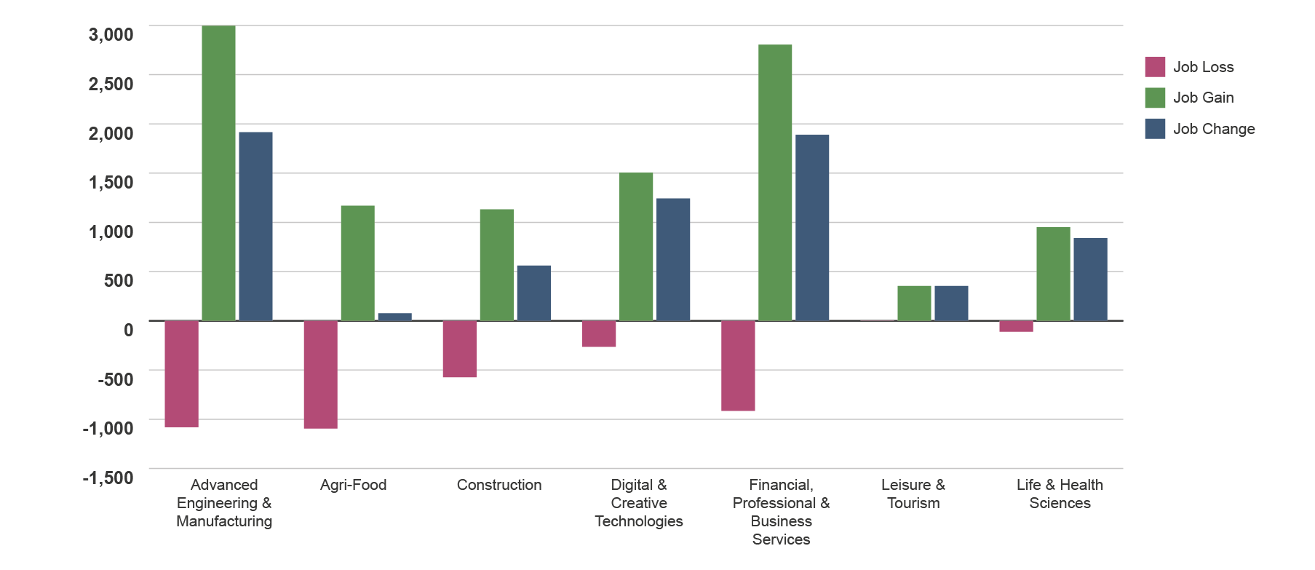
Cohort Job Change by Sector
2021 to 2022

Slide 30
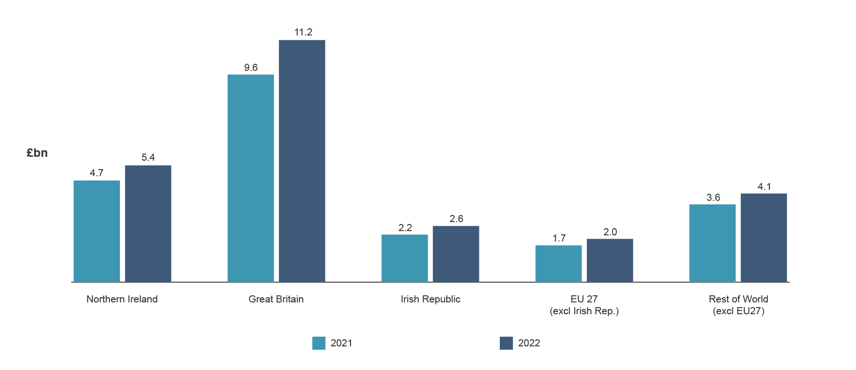
Cohort Growth by Key Markets
2021 to 2022

Slide 31
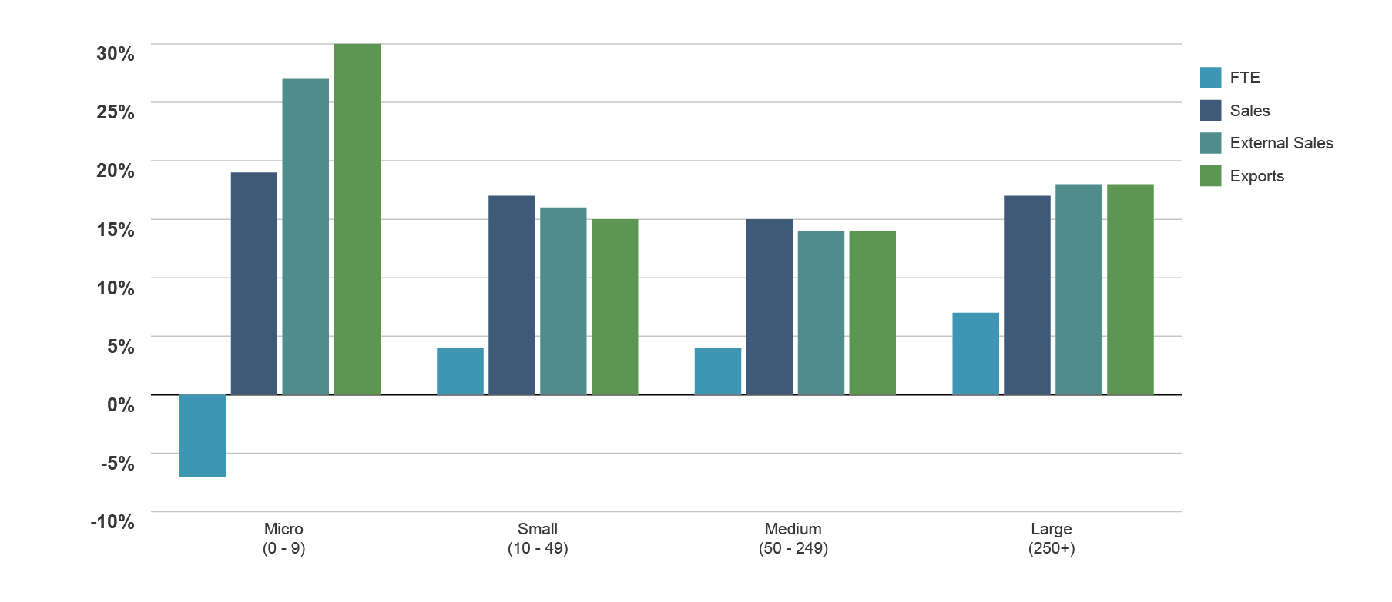
Cohort Growth by Business Size
2021 to 2022

