Slide 1
UK Trader Scheme and Apportionment
April 2021

Slide 2
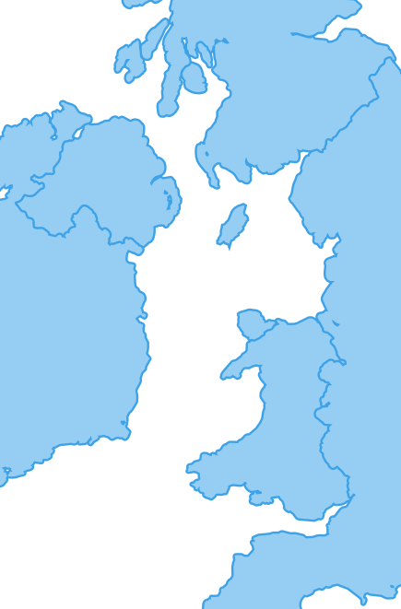
Goods from GB/ imported to GB then moved to NI
You’ll need to make declarations and may need to pay tariffs when bringing goods into Northern Ireland from Great Britain or from outside the EU.
Goods from Great Britain will not pay any tariffs when they move into NI if they are not deemed to be at risk of leaving the UK customs territory. However, goods ‘at risk’ of entering the EU’s single market will pay EU tariffs.
If goods are not ‘at risk’ on import from the rest of the world the UK tariff is payable.
GB

Slide 3
Goods always ‘at risk’ and goods automatically not ‘at risk’
Goods always 'at risk' so tariffs are chargeable:​
Goods subject to commercial processing in NI and the additional processing criteria is not met​
Goods from outside the UK/EU where the EU duty is more than 3 % points greater than the UK duty ​
Goods where no tariffs are chargeable​
Goods where the UK duty is equal to or higher than the EU duty​. For GB-NI movements there is no UK duty so this means goods where the EU tariff is zero ​
A business may use the UK-EU TCA to claim a preferential rate of duty on entry to NI where origin requirements are met​
This would mean the goods are automatically not at risk.​
A business does not require a UK Trader Scheme authorisation to declare these goods not at risk

Slide 4
Goods brought into NI which can be declared not at risk
If the EU tariff is higher than the UK tariff, goods brought into Northern Ireland directly from countries outside of the EU and the UK can still be declared not ‘at risk’ where all of the following are true:
the difference between the applicable EU tariff and the applicable UK tariff is less than 3 percentage points
the goods are for sale to, or final use by, end consumers located in Northern Ireland
you are authorised under the UK Trader Scheme and hold sufficient evidence to declare your goods not ‘at risk’
the goods are for sale to, or final use by, end consumers located in Northern Ireland and are brought into Northern Ireland by a trader authorised under the UK Trader Scheme
https://www.gov.uk/guidance/check-if-you-can-declare-goods-you-bring-into-northern-ireland-not-at-risk-of-moving-to-the-eu

Slide 5
Options for moving goods from GB-NI
There are a number of options available to consider when moving goods into Northern Ireland from Great Britain.
When bringing goods into Northern Ireland from Great Britain, you’ll pay no duty if you’re:
able to claim a preferential rate of duty under the Trade and Cooperation Agreement between the UK and EU
authorised under the UK Trader Scheme and declare that your goods are not ‘at risk’ of onward movement to the EU
eligible to claim a waiver on the duty up to specified limits

Slide 6
UK Trader Scheme
Where the applicable EU tariff is above zero, goods brought into Northern Ireland from Great Britain can still be declared not ‘at risk’ if you are authorised under the UK trader scheme when they meet ‘final use’ criteria, meaning they are for sale to, or final use by, end consumers located in the UK (please note the UKTS can also be used to declare goods for a business’ own use).
The UKTS is open to businesses in all sectors and of all sizes who are:
Established in NI, or
Established elsewhere
and have customs operations carried out in the UK
and have indirect representation in NI
and have a fixed place of business in NI where records are available and where goods are sold to, or provided for final use by end-consumers, and
Have no history of serious customs or tax infringements or other similar criminal offences of an economic nature, and
Have sufficient controls of operations and record keeping to ensure can provide evidence to support not at risk declarations.
If the goods you bring into Northern Ireland will be subject to processing, you must also meet additional criteria.

Slide 7
UK Trader Scheme – temporary easement
If you supply goods to a business in Northern Ireland but do not have a fixed address in Northern Ireland
Temporary approach if:
you do not have a fixed address in Northern Ireland
you supply goods to a business in Northern Ireland which has a fixed place of business from where those goods are provided for, or sold to end consumers, and that business is either:
provisionally authorised under the UK Trader Scheme
could be provisionally authorised, were they the importer of those goods
To be authorised to declare goods not ‘at risk’, you must
meet all of the other UK Trader Scheme criteria
be able to declare not ‘at risk’ for end-use or sale to end consumers in the UK
There is further detail on the application process on gov.uk
This easement ends 31 October 2021.

Slide 8
Apportionment
For businesses that don’t know the final destination of all the goods in a consignment on entry to NI, you may be able to avail of apportionment providing you:
have a stable pattern of these movements over a few years, allowing accurate assessment of proportion of consignments which are not at risk are UKTS authorised and be able to provide evidence on request
review the apportionment periodically and make an amendment for any over or under payments.
You will need to state that you plan to use apportionment when you apply to UKTS, or inform UKTS that you will be doing this if you are already authorised.

Slide 9
Waivers
Businesses can claim a waiver for duty on goods brought into Northern Ireland from Great Britain which might otherwise incur ‘at risk’ tariffs if they have not exceeded the allowances set out below at the point the import declaration is submitted.
How much you can claim
If you are eligible to claim a waiver you must do this at the point your import declaration is submitted.
Waivers for duty on goods that would otherwise incur ‘at risk’ tariffs are provided in the form of ‘de minimis aid’.
This is measured in euros.
Allowances and de minimis aid
Most businesses can claim up to a maximum of €200,000 of aid over 3 tax years, lower allowances apply for certain sectors.
The period of 3 years is assessed on a rolling basis.
The maximum allowance includes all de minimis aid you claim over a period of 3 tax years such as:
de minimis aid unrelated to waivers for Customs Duty
de minimis aid granted through any other scheme - such as Employment Allowance

Slide 10
Guidance: Customs under the NI Protocol
Guidance on EORI numbers for the type of movements being made - link
Customs, VAT and Excise guidance on moving goods into and out of Northern Ireland- link
Link to the Trader Support Service, a free-to-use service which will help businesses and traders prepare for changes that will affect business if moving goods in and out of Northern Ireland - link
Check if you can declare goods not ‘at risk’ - link
Apply for authorisation for the UK Trader Scheme – link
Guidance on sending parcels to and from Northern Ireland – link
Using CHIEF to move goods into or out of Northern Ireland - link
Hauliers wanting to move goods through a port in the UK that uses the Goods Vehicle Movement Service (GVMS) will need to register for the service to get goods through customs. - link
For some traders, there may be advantages to moving goods under Common Transit (also referred to as CTC movements, which stands for the Common Transit Convention). Information about how to do that is available here.
Movements of goods from Ireland to Great Britain, if not done under Common Transit, follow the process for importing goods from the European Union into Great Britain.
Movements of goods from Great Britain to Ireland, if not done under Common Transit, follow the process for exporting goods from Great Britain into the European Union.

Slide 11
NI Customs & Trade Academy / TSS
NICTA has wide range of short courses and TSS How-to Guides on all aspects of new trading processes that took effect from 1 January 2021​
For more information visit:​
https://www.nicustomstradeacademy.co.uk/​
Data requirements ​
Preparation steps ​
Step-by-step User Guide ​
Recording of the Supplementary declaration demo ​
Error Code Guidance here​
Recording of the Tariff on goods movements into NI webinar ​

Slide 12
Q&A
Any questions?

