Slide 1
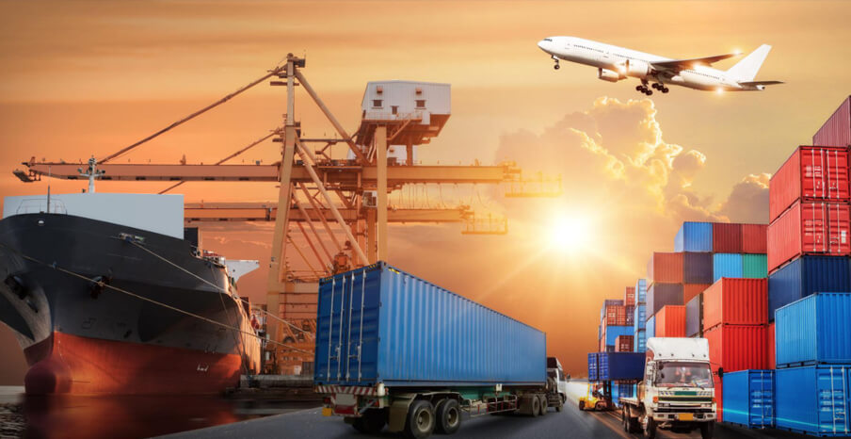

Transit Options for NI Businesses
Ronan McDonnell

Slide 2
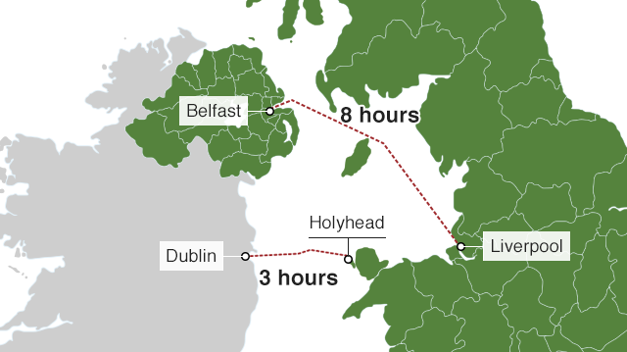
Context for presentation
Large % NI traders/hauliers traditionally used Dublin Port.
Period of adjustment:
  Drop in volumes of 50% at Holyhead
  Volumes on the GB-NI routes increased 5%
  Transit required for landbridge option
  Traders avoiding landbridge to Europe
  No significant delays at Channel ports
How can NI businesses use Transit?
What does this involve? Overview.

Slide 3
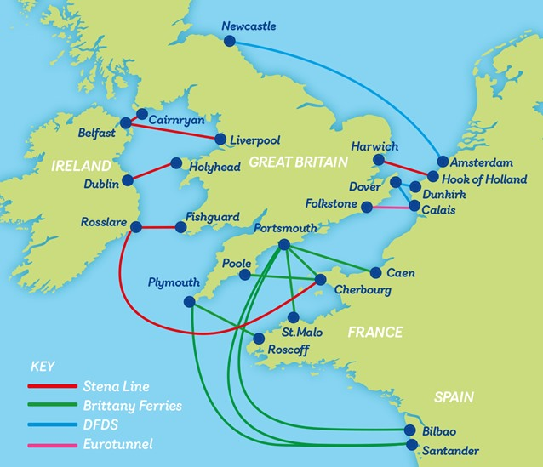
What is meant by Transit?
Procedure that allows you to move goods between two points in a customs territory without paying tariffs and taxes at each point.
Allows for streamlined customs arrangements to:
  Facilitate flow of goods,
  Minimise administration costs
  Reduce delays at borders
Transit document is opened in the sending territory, passes through offices of transit (borders) and arrives at its intended destination where the document is closed.
The cargo must be identifiable and/or sealed so that any leakage can be easily detected.

Slide 4
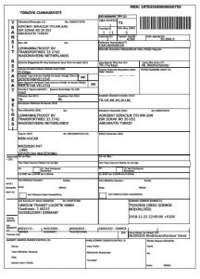
What is meant by Transit?
The movement is secured by transit guarantee.
  Should cover the duty/VAT liability for all goods you are likely to have in transit at any one time.
  As a guide, consider 20% of the value of goods in transit.
Transit movement can start at an office of departure in the sending territory and end at office of destination.
“Authorised Consignor” and “Authorised Consignee” empowered by Customs to send/receive goods directly from/at their premises without having to present them at office of departure/destination.

Slide 5
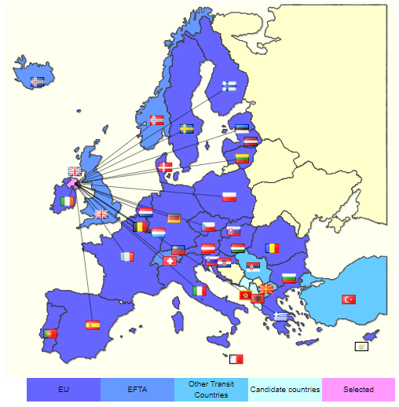
NI Transit Activity 2021
https://ec.europa.eu/taxation_customs/dds2/tra/transit_emap.jsp?Lang=en

Slide 6
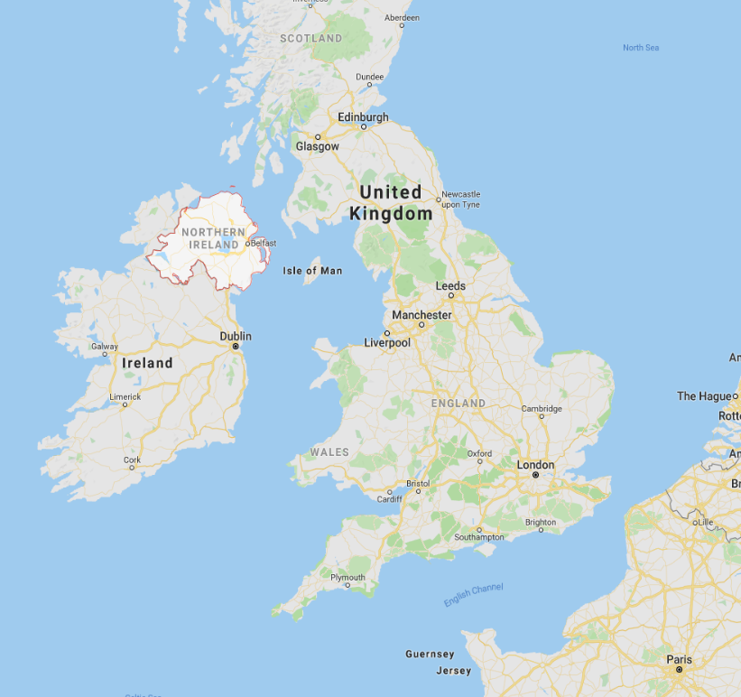
GB-NI via ROI
Two ways for goods to move from GB to NI via ROI ports:
  Direct import into ROI: Goods declared at point of entry into ROI
  Transit: Goods move through ROI and declared on arrival in NI,
TSS supports Transit by submitting these documents :
  Safety & Security (ENS) declaration into the Irish Control System (ICS)
  Entry into the New Computerised Transit System (NCTS)
  NI import declarations – Simplified Frontier and Supplementary declaration
Enables hauliers to use the TSS Transit Guarantee
TSS does not assist with:
  Pre-Boarding Notifications (PBN) for the Irish Roll-On-Roll-Off (RoRo) service
  Additional declarations and processing of documents for SPS/excise/controlled goods
For more information:
  https://www.nicustomstradeacademy.co.uk/resources/transit/
  https://www.nicustomstradeacademy.co.uk/resources/webinars/#irish-ports
  Irish Revenue publication Customs Advice for Drivers using Dublin Port

Slide 7
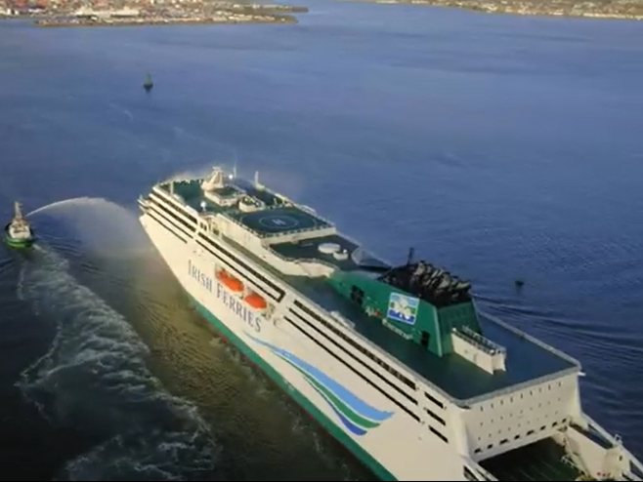
GB-NI via ROI – Start Moving the Goods in GB
Trader or haulier uses TSS Transit service to submits ENS declaration to Irish ICS system and receives ENS Movement Reference Number (MRN).
Submit a Transit declaration to NCTS, generating a Transit Local Reference Number (LRN). TSS provide the Transit LRN to haulier.
TSS generates Simplified Frontier Declaration (SFD).
TSS completes Border Force notification on haulier’s behalf if option to end the Transit at an Office of Destination at Belfast, Larne or Warrenpoint ports.
Haulier takes the Transit LRN to an Office of Departure along with the goods:
  Transit Accompanying Document (TAD) generated for each consignment
  Transit Movement Reference Number (MRN) generated for load
  Transit movement can proceed

Slide 8
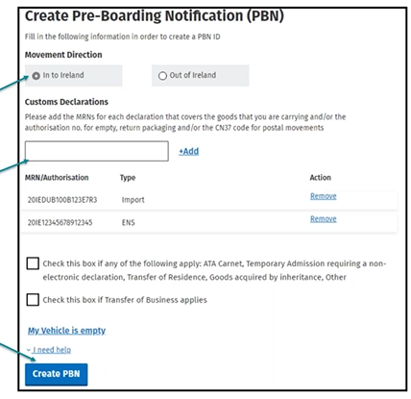
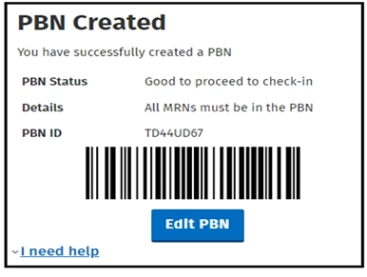
GB-NI via ROI – Before Entering the Port
Before arriving at GB port, haulier must make Pre-Boarding Notification (similar to GMR) to Irish RoRo Service.
  Select movement direction – Into Ireland
  Input MRN from ENS and select Add
  Input MRN from TAD
  (Add further MRN’s for other consignments, if required)
  Click Create PBN
Notification enables Irish authorities complete the customs process.
Check channel lookup 30 minutes before entering Irish port using PBN ID.
Learn about the PBN notification process in webinar https://www.nicustomstradeacademy.co.uk/resources/webinars/#irish-ports
NB TSS does not support this function but will provide advice to hauliers who are having difficulties with it.

Slide 9
GB-NI via ROI – Moving SPS Goods
If using Transit to move goods SPS goods, documents must be prepared and entered onto the EU’s TRACES system:
  As if they are destined for Ireland
  24 hours before your movement starts
NI importer responsible for upload Export Health Certificates and other SPS documents onto the Irish TRACES system.
Learn about the SPS process in presentation by Ireland’s Department of Agriculture, Food and the Marine (from minute 40) https://www.nicustomstradeacademy.co.uk/resources/webinars/#irish-ports
Information on Traces https://www.daera-ni.gov.uk/articles/information-traces

Slide 10
GB-NI via ROI – Delivering Goods to NI
Goods must be taken directly to an Authorised Consignee location in NI or an Office of Destination where the Transit can be closed.
Alternatively, TSS will notify Border Force of Point of Unloading.
If you go to an Authorised Consignee location, they will notify the Office of Destination and confirm if inspection is required.
Otherwise, Authorised Consignee carries out necessary checks and informs driver that the goods have been released and can proceed to their unloading location.
If Border Force inspection is required, conducted at the Authorised Consignee or Office of Destination location.
Complete Supplementary Declaration, as normal.

Slide 11
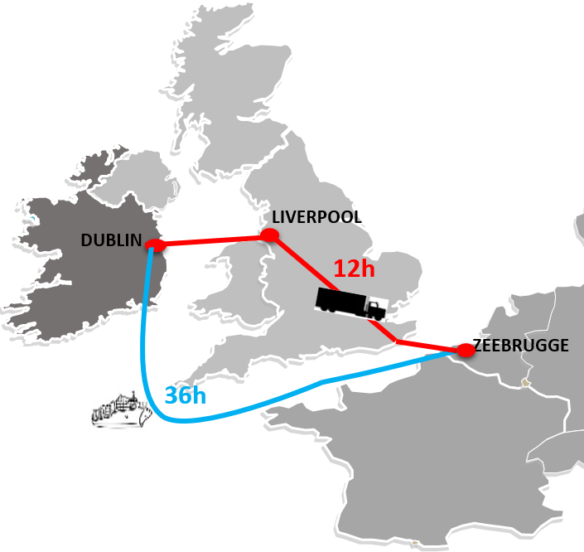
Trade with EU – Transiting Landbridge
NI businesses can trade freely within the EU Single Market.
Transit is required for movements via GB landbridge.
Goods pass through GB without payment of duty/VAT and arrive back in EU identifiable as EU goods.
Similar process for NI and ROI consignments with Office of Departure on IOI.
Landbridge process not supported by TSS.
Should discuss with haulier/3PL and/or engage specialist Transit service provider.
Consider requirements: guarantee, software (PBN, GVMS, French ENS, etc.)
https://www.gov.ie/en/publication/087a5-moving-goods-under-transit-procedure-via-the-uk-landbridge-ireland-great-britain-france/

Slide 12
Trade with EU – Transiting Landbridge
PBN submitted to Irish Customs in advance of the goods leaving Ireland.
Entry to GVMS also required.
Present Transit Documents at check-in for scanning.
Office of Transit formalities completed electronically on entry to GB.
Check a Heavy Goods Vehicle checks outbound UK-EU freight vehicles before they get close to the port.
ENS declaration must be lodged to the French ICS system.
Goods must be presented on continent so transit can be concluded.
There may still be a requirement for SPS controls upon re-entry to EU.

Slide 13
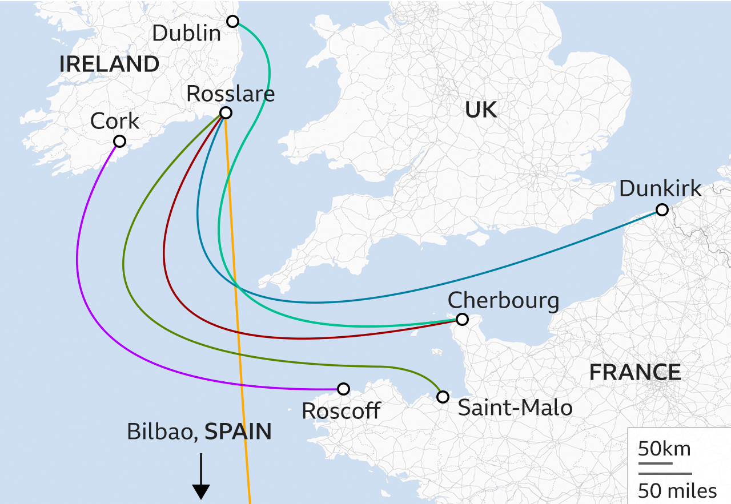
Ireland/EU/Ireland – Direct Ferries
Dublin – Cherbourg Irish Ferries
Rosslare – Cherbourg Brittany Ferries
Dublin – Cherbourg Stena Line
Rosslare – Dunkirk DFDS
Dublin – Zeebrugge/Rotterdam CLdN
Cork – Roscoff Brittany Ferries
Rosslare – Roscoff/Bilbao Brittany Ferries

Slide 14

In Summary
Consider strategies to minimise costs/risks.
Engage with hauliers.
Engage with suppliers and customers.
Determine responsibilities.
Familiarise with systems and procedures.
Seek out assistance.

Slide 15
