Slide 1
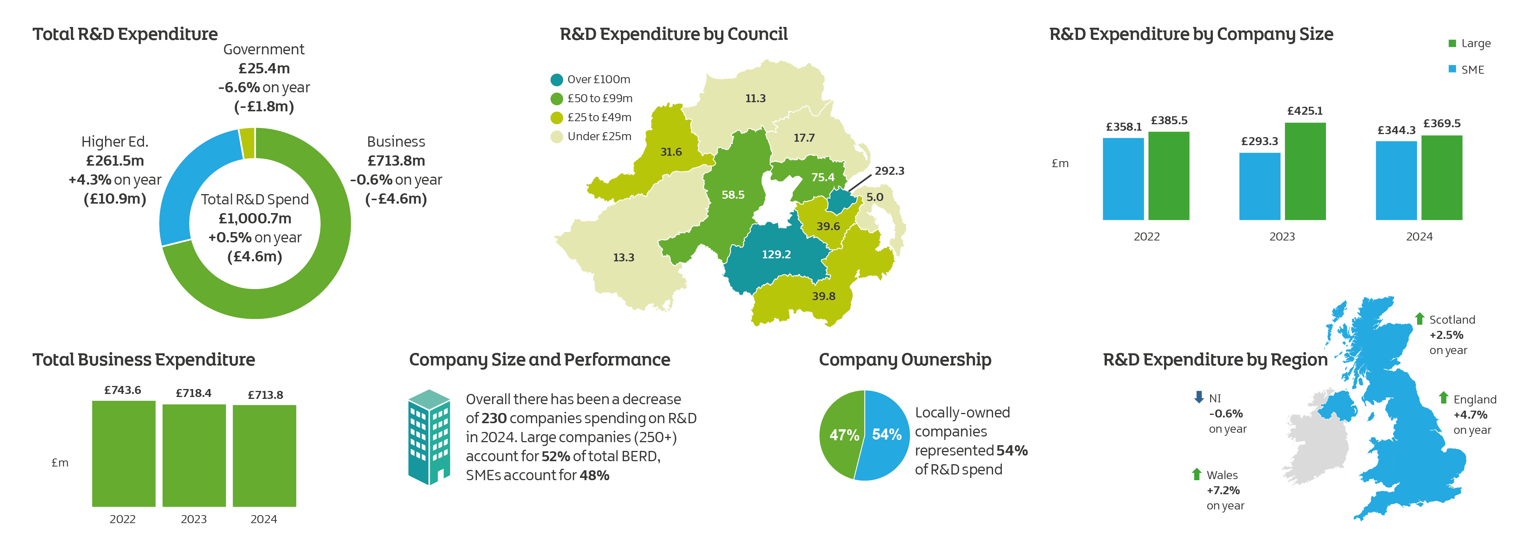
R&D Survey – Headline Results
2024

