Slide 1
Sector Presentation on
Invest NI Supported Businesses
Materials Handling

Slide 2
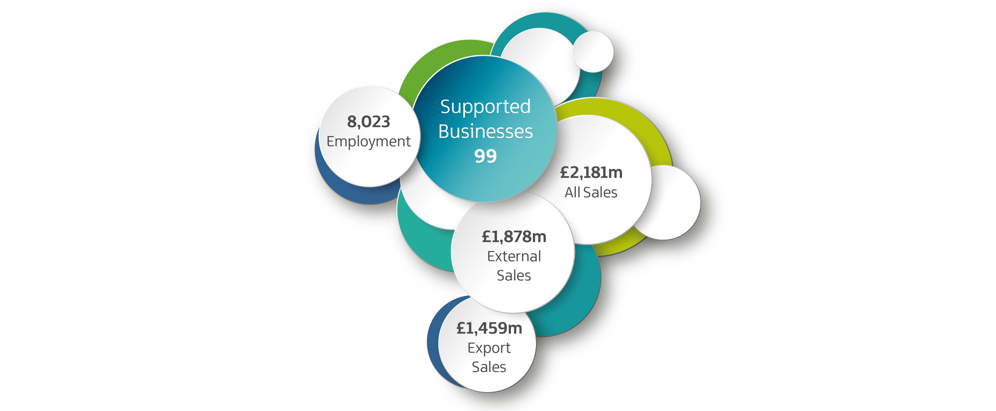
Materials Handling Sub-Sector
2024

Slide 3
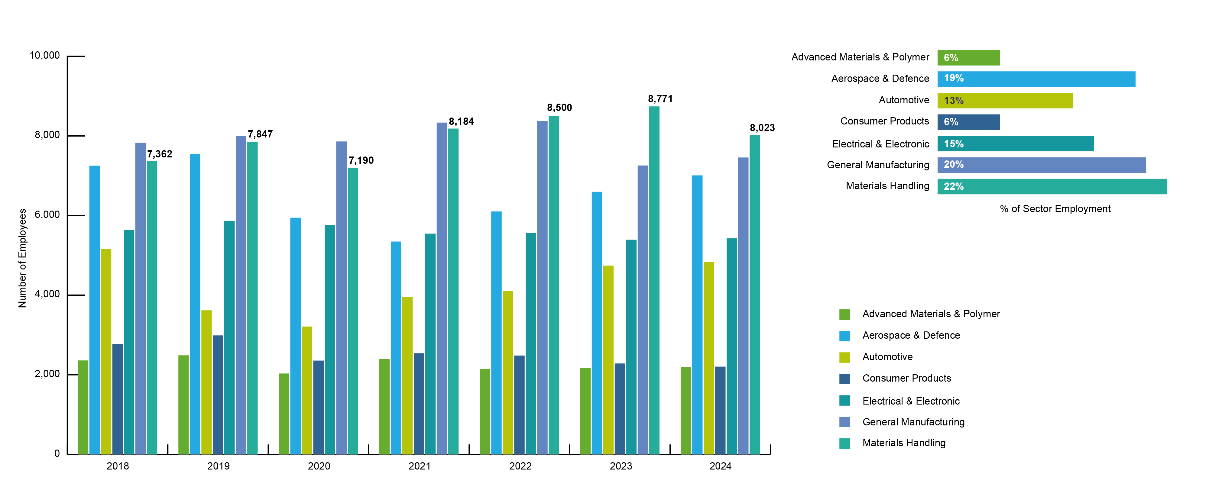
Employment by Sub-Sector
2018 - 2024

Slide 4
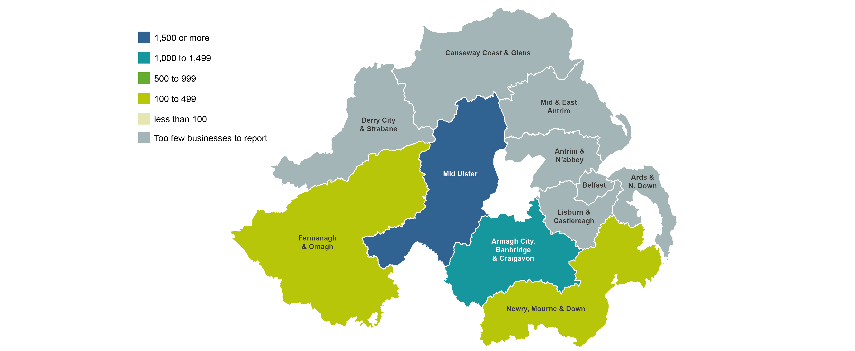
Employment by Location
2024

Slide 5
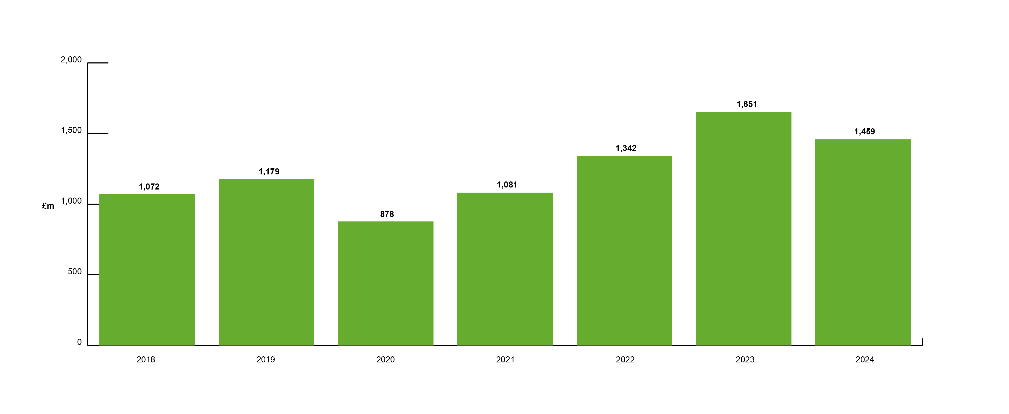
Export Growth
2018 - 2024

Slide 6
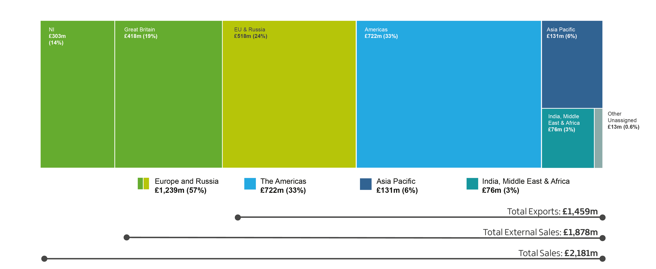
Sales by Market Destination
2024

Slide 7
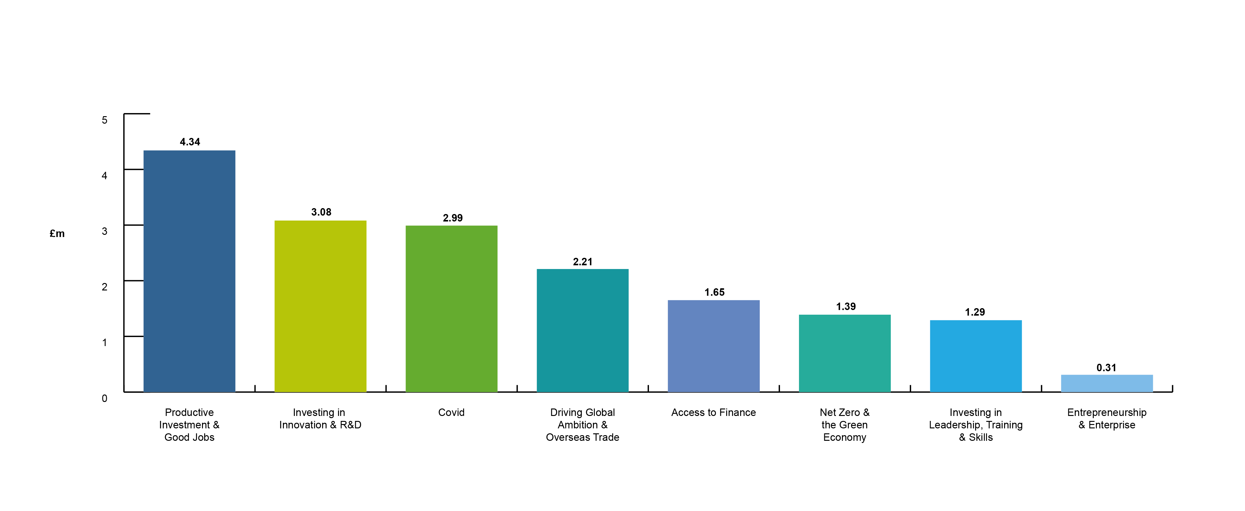
Invest NI Support Offered (£m)
2020-21 to 2024-25

Slide 8
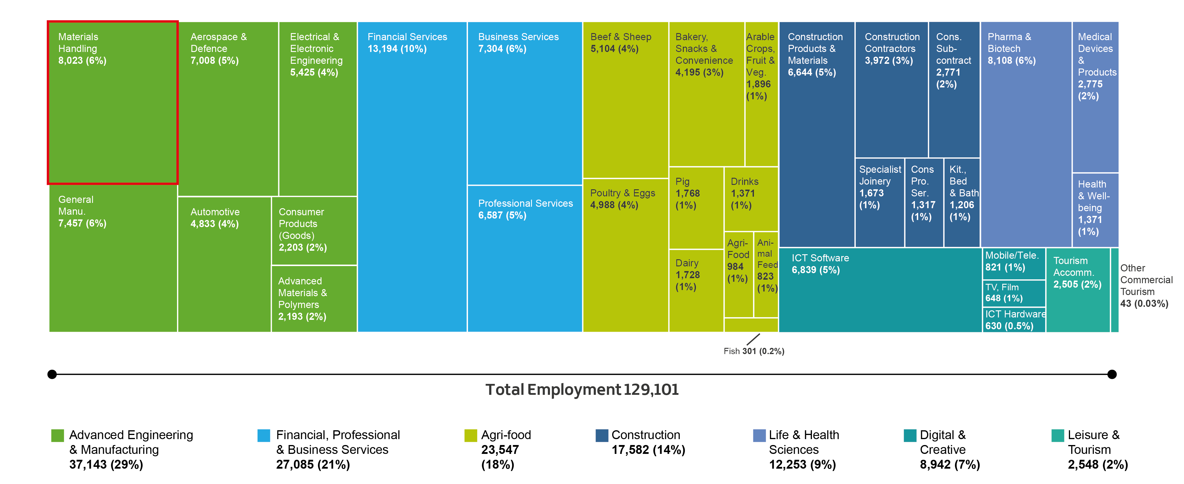
Northern Ireland’s Sector Analysis from KPIs
2024

