Slide 1

Shopper Insight Report
(52 week(s) from 02/05/2016 to 30/04/2017)
This reports covers the Northern Ireland Region

Slide 2
Contents
Summary & Recommendations
Key Performance Indicators (KPIs):
Sales Growth
Customer Penetration
  % of shoppers
Customer Loyalty
  Repeat purchase rate
Shopper Profiles
Meeting a distinct need?
  Segmentation (lifestage, lifestyle, family)
Store Performance
Distribution
  Penetration
  Local identity
Glossary of Terms

Slide 3
Summary & Recommendations

Slide 4
Overview
Performance Measure | SKU1 | SKU2 | SKU3
1. Sales growing? (Slide 9) | Yes | Yes | No
2. Sales growth > product group as a whole? (Slide 9) | Yes | Yes | Yes
3. Penetration growing? (Slide 9) | Yes | Yes | No
4. Penetration > average for all SKUs? (Slide 9) | No | Yes | Yes
5. Growth in penetration > growth in distribution? (Slide 9) | No | No | No
5. Repeat rate growing? (Slide 9) | Yes | Yes | No
6. Repeat rate > average for all SKUs? (Slide 9) | No | Yes | Yes
8. Meeting a distinct need? (Slide 13-15) | Yes | No | Yes
9. Strong (brand) demand in top performing stores? (Slide 18) | Yes
10. Short ‘tail of insignificance’? (Slide 18) | Yes
11. Strong local~ (brand) demand? (Slide 19) | Yes
Recommendation 1: Focus on your core stores – those in which demand (penetration) is highest. This will ensure you get the best return on the allocation of your (limited) marketing resources.
Recommendation 2: Focus on increasing penetration (trial) & repeat rate (loyalty) but don’t rely exclusively on discounting as your customers are not driven by price alone. Consider using recipe ideas, local advertising (radio & press) and social media, in tandem with targeted price promotions to raise awareness and build a community of interest.
~Local refers to county in which brand is produced

Slide 5
Key Performance Indicators (KPIs)

Slide 6
KPIs – What to look for*
Your sales are growing and by more than the product group as a whole – you are over-performing
Your customer penetration is growing and above the average for all SKUs – you are appealing to more people than your competitors
Your repeat rate is growing and above the average for all SKUs – your have higher customer loyalty than your competitors
Your growth in customer penetration is greater than your growth in distribution – demand ‘pull’ is stronger than supply ‘push’
Your sales are falling and/or growth is below the product group as a whole – you are under-performing
Your customer penetration is falling or below the average for all SKUs – your appeal is declining or less than your competitors
Your repeat rate is falling or below the average for all SKUs – your customer loyalty is declining or lower than your competitors
Your growth in customer penetration is less than your growth in distribution – demand ‘pull’ is weaker than supply ‘push’
*Penetration and Repeat Rate account for 60% of Tesco’s Customer Performance Score (CPS). Focus on increasing these and your other KPIs will take care of themselves

Slide 7
KPIs – Summary: GREAT PRODUCTS- F16IE
SKU | Product Name | Growth in Sales Value (%) | Penetration (%) | Growth in Penetration (%) | No. of Stores Selling | Growth in No. of Stores Selling | Repeat Purchase Rate (%) | Growth in Repeat Rate (%)
1 | GREAT PRODUCT 1 500G | 630.6% | 3.18% | 252.17% | 19 | -34.5% | 29.22% | 1754.53%
2 | GREAT PRODUCT 2 500G | 926.5% | 15.91% | 1270.28% | 53 | 55.9% | 43.95% | 2761.03%
3 | GREAT PRODUCT 3 | -10.1% | 16.29% | -161.76% | 35 | 2.9% | 55.23% | -110.69%
Average for all SKUs in the product group |  | - | 6.64% | 267.51% | 33 | 9.98% | 32.09% | -
Total product group |  | -14.3% | 26.81% | -102.80% | 54 | 5.9% | 59.76% | -35.09%

Slide 8
Shopper Profiles

Slide 9
Shopper Profiles – What to look for
Your product appeals to segments which under-index in the product group as a whole – demand for your products is distinctive and has the potential to grow the value of the product group as a whole
Your product appeals to ‘finer food’ shoppers – most likely to experiment with new/niche products, least interested in price promotions and most likely to repeat purchase if the product meets expectations
Your product appeals to segments which over-index in the product group as a whole - your product is not meeting a distinct customer need and is vulnerable if KPIs are below average
Your product appeals to ‘price sensitive’ shoppers – least likely to experiment or repeat purchase unless products are on promotion

Slide 10
Lifestage Segmentation – SKUs meeting a distinct need
SKU | Product Name | Older Adults | Older Families | Pensioners | Young Adults | Young Families
1 | GREAT PRODUCT 1 500G | 101 | 124 | 108 | 70 | 100
2 | GREAT PRODUCT 2 500G | 94 | 119 | 99 | 71 | 118
3 | GREAT PRODUCT 3 | 94 | 100 | 146 | 67 | 98
Total product group (GREAT PRODUCT - F16IE) |  | 95 | 109 | 119 | 72 | 107
Segments that are under-served by the product group as a whole (Index <100)
SKUs that have strong appeal within under-served segment (Index >100)

Slide 11
Lifestyle Segmentation – SKUs meeting a distinct need
SKU | Product Name | Convenience | Finer Foods | Kids Choice | Mainstream | Price Sensitive | Traditional
1 | GREAT PRODUCT 1 500G | 79 | 133 | 65 | 85 | 126 | 97
2 | GREAT PRODUCT 2 500G | 85 | 112 | 96 | 97 | 111 | 92
3 | GREAT PRODUCT 3 | 84 | 119 | 73 | 105 | 93 | 129
Total product group (GREAT PRODUCT - F16IE) |  | 86 | 116 | 87 | 99 | 101 | 110
Segments that are under-served by the product group as a whole (Index <100)
SKUs that have strong appeal within under-served segment (Index >100)

Slide 12
Family Segmentation – SKUs meeting a distinct need
SKU | Product Name | Carol | Dawn | The Mayers | Roshni | The Wicks
1 | GREAT PRODUCT 1 500G | 88 | 123 | 115 | 71 | 105
2 | GREAT PRODUCT 2 500G | 88 | 104 | 125 | 71 | 115
3 | GREAT PRODUCT 3 | 106 | 127 | 107 | 67 | 95
Total product group (GREAT PRODUCT - F16IE) |  | 98 | 112 | 114 | 72 | 105
Segments that are under-served by the product group as a whole (Index <100)
SKUs that have strong appeal within under-served segment (Index >100)

Slide 13
Store Performance

Slide 14
Store Performance – What to look for
Penetration is above the average for all SKUs in the product group in your top performing stores – your brand is relevant and you can confidently target these stores (and similar ones not currently listed) for growth
Penetration is above average in the majority of stores listed in your home county – your brand has a strong regional identity
You have a short ‘tail of insignificance’ (stores with below average penetration) – poor performing stores drag down your KPIs and drain your scarce resources, so the fewer the better
Penetration is below the average for all SKUs in the product group in your top performing stores - your brand is not relevant to enough people. If it was de-listed tomorrow very few people would notice!
Penetration is below average in the majority of the stores listed in your home county – your brand has a weak regional identity
You have a long ‘tail of insignificance’ (stores with below average penetration) – poor performing stores drag down your KPIs and drain your scarce resources, so the fewer the better

Slide 15
Top 20 stores ranked by customer penetration
These are your core stores
Strong demand in your top performing stores – 20/20 have customer penetration above the average of all SKUs
Short tail of insignificance – 60% of all 53 stores listed have penetration above the average for all SKUs.

Slide 16
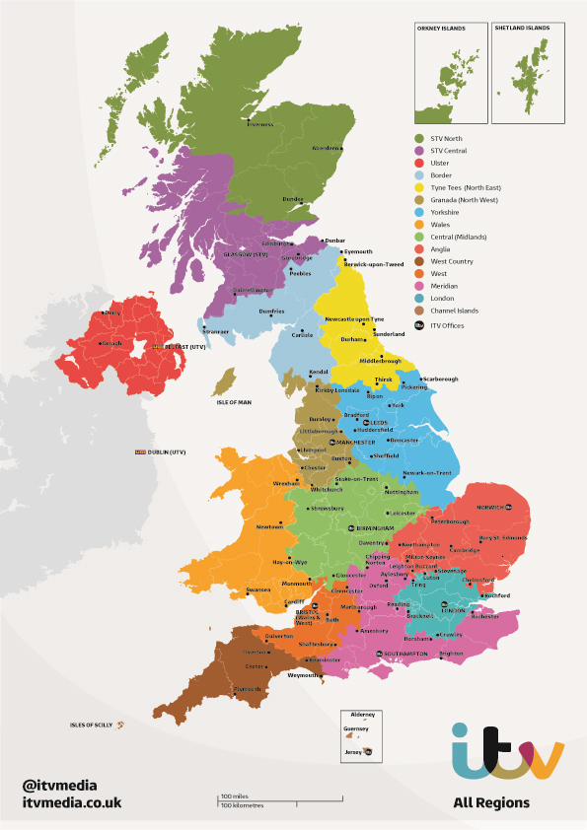
Regional Distribution
Strong regional demand – 80% of Co. Down stores have customer penetration above the average for all SKUs

Slide 17
Glossary of Terms

Slide 18
KPIs
Customer Penetration
  % of shoppers who have purchased your product(s) at least once during the specified period
  Indication of the popularity of your product(s)
  Contributes 30% towards the Consumer Priority Score (CPS)
Repeat purchase rate
  % of shoppers who have purchased your product(s) at least twice during the period
  Indication of customer satisfaction and loyalty
  Contributes 30% towards the Consumer Priority Score (CPS)

Slide 19
Customer Priority Score (CPS)
The Customer Priority Score (CPS) = an average score of 4 key customer metrics
CPS Score
Source: dunnhumby (2016)

Slide 20
Customer Profiling
Shopper profiles are presented in index form, with 100 representing the average for all supermarket shoppers
110
10%
Over-indexing segments purchase a disproportionately high share – they find them appealing
Under-indexing segments purchase a disproportionately low share – they find them less appealing
more likely
100
100
90
10%
less likely

Slide 21
Lifestage Segmentation
Lifestage segment
%
shoppers
Age & family
Young Adults
20%
Adults aged 20-39
with no children
Older Adults
17%
Adults aged 40-59
with no children
Young families
23%
Adults with all
children under 10
Older families
21%
Adults with one or
more child over 10
Pensioners
19%
Adults over 60
with no children
Source: dunnhumby (2016)
Mixed
8%

Slide 22
Lifestyle Segmentation
Lifestyle segment
%
shoppers
Description
Convenience
14%
Regard food as fuel, are busy and rely heavily on the microwave
Finer Foods
14%
Time conscious, enjoy luxury products and are willing to experiment
Kids Choice
9%
Young families influenced by the needs of children
Mainstream
31%
Have broad tastes and favour established brands
Price Sensitive
24%
Look primarily for value and rely on staple foods
Mixed
8%
Enjoy the art of cooking but rely on a fixed shopping list so less likely to buy on impulse
Traditional
8%
Source: dunnhumby (2016)

Slide 23
Family Segmentation
Family segment
%
shoppers
Description
Roshni
Balancing work and socialising makes for busy, interesting but occasionally challenging lives for young people without children
21%
The Wicks
18%
Tired, stressed and stretched, lower affluent families find life a battle
The Mayers
13%
Busy, stressed and stretched, higher affluent families are trying to do it all
Carol
19%
Life is simpler for the lower affluent empty nesters
Dawn
29%
The high affluent post family have both the money and time to enjoy themselves
Mixed
8%
Source: dunnhumby (2016)
Traditional
8.2%

